Slide 1
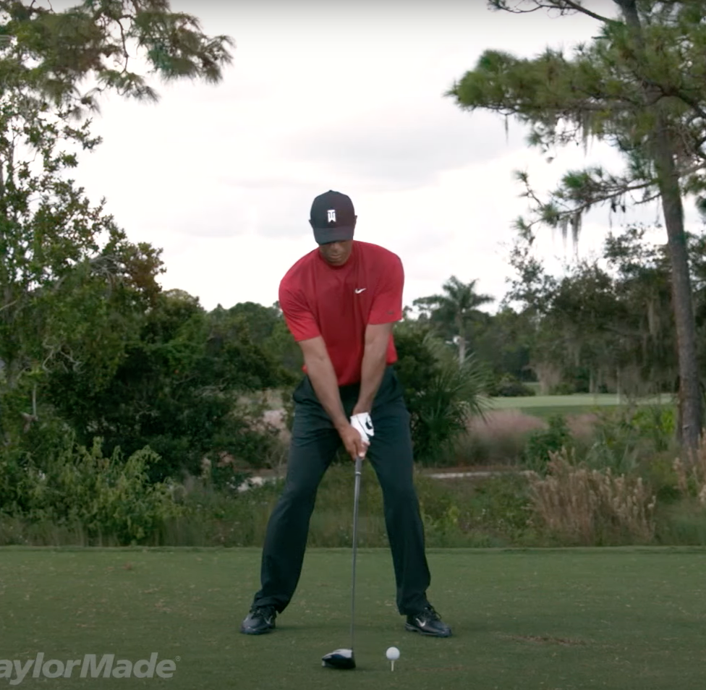
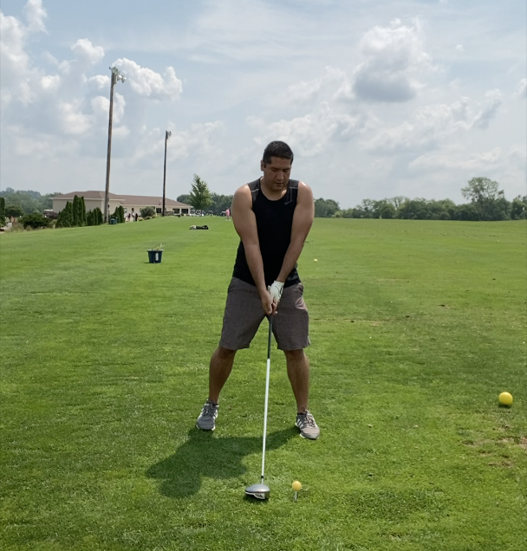
Tiger Left elbow angle: 187 deg
Luis Left elbow angle: 189 deg

Slide 2
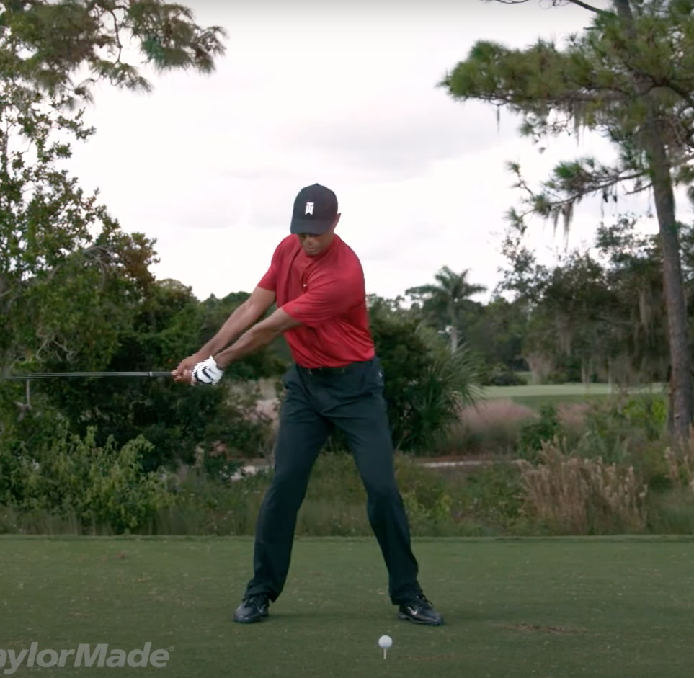
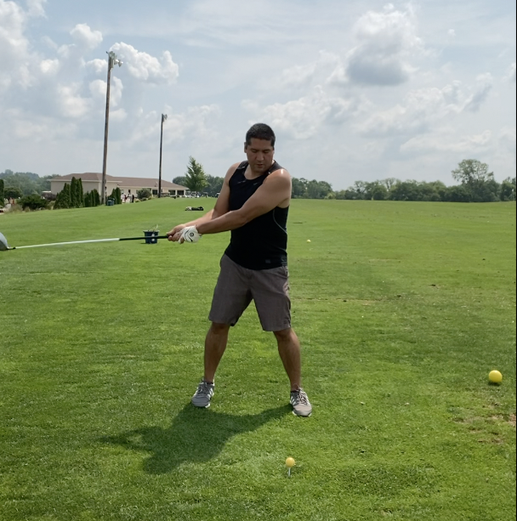
Tiger Left elbow angle: 135 deg
Luis Left elbow angle: 201 deg

Slide 3
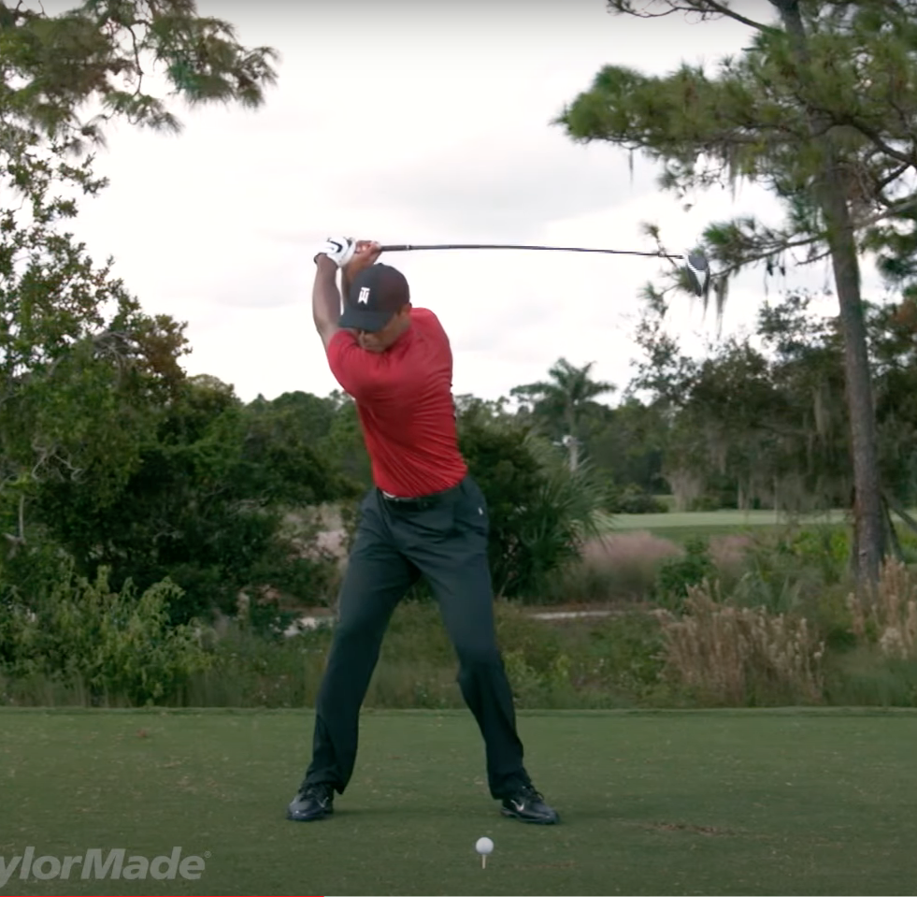
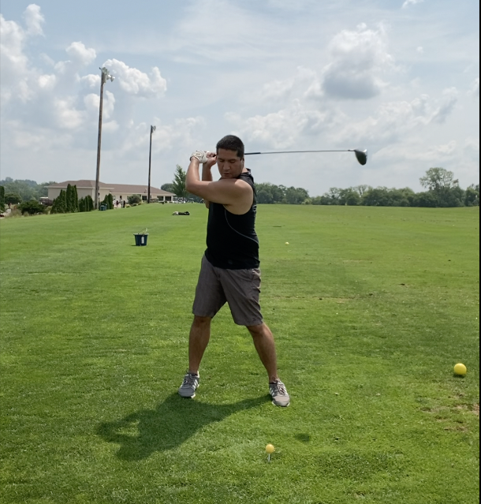
Tiger Left elbow angle: 225 deg
Luis Left elbow angle: 263 deg

Slide 4
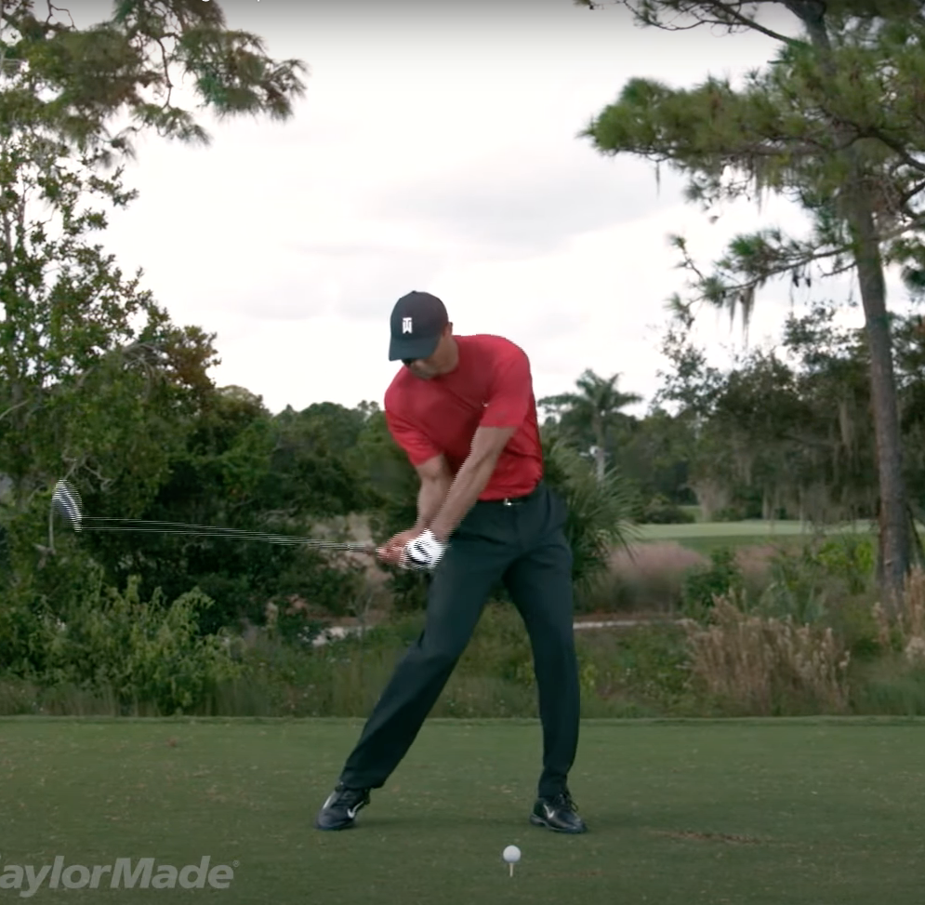
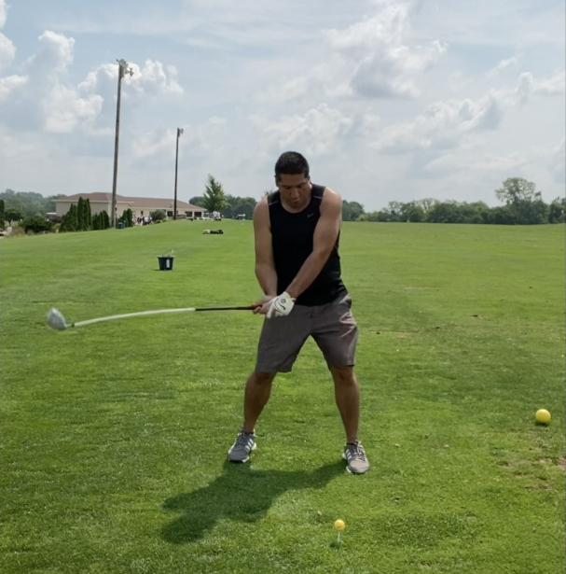
Tiger Left elbow angle: 194 deg
Luis: Left elbow angle: 190 deg

Slide 5
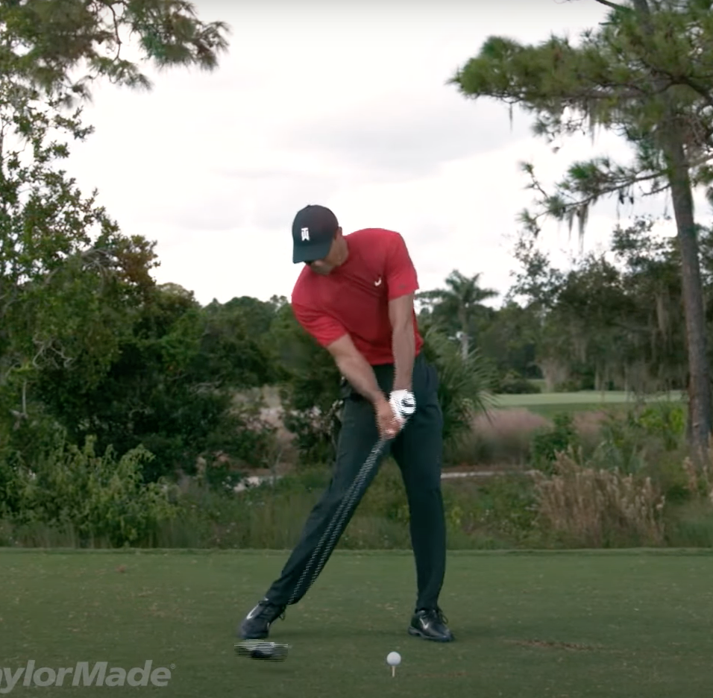
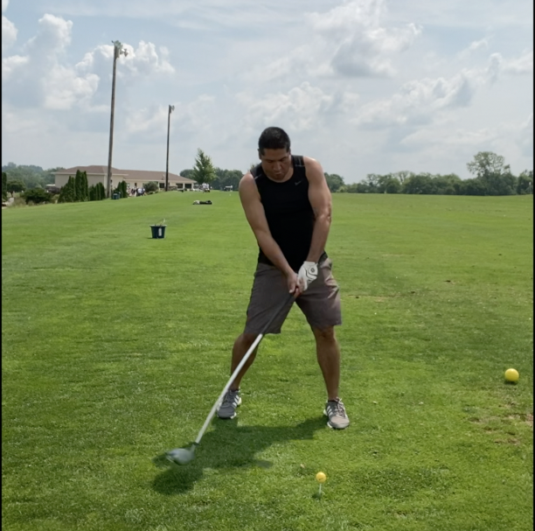
Luis: Left elbow angle: 185 deg
Luis: Left elbow angle: 207 deg

Slide 6
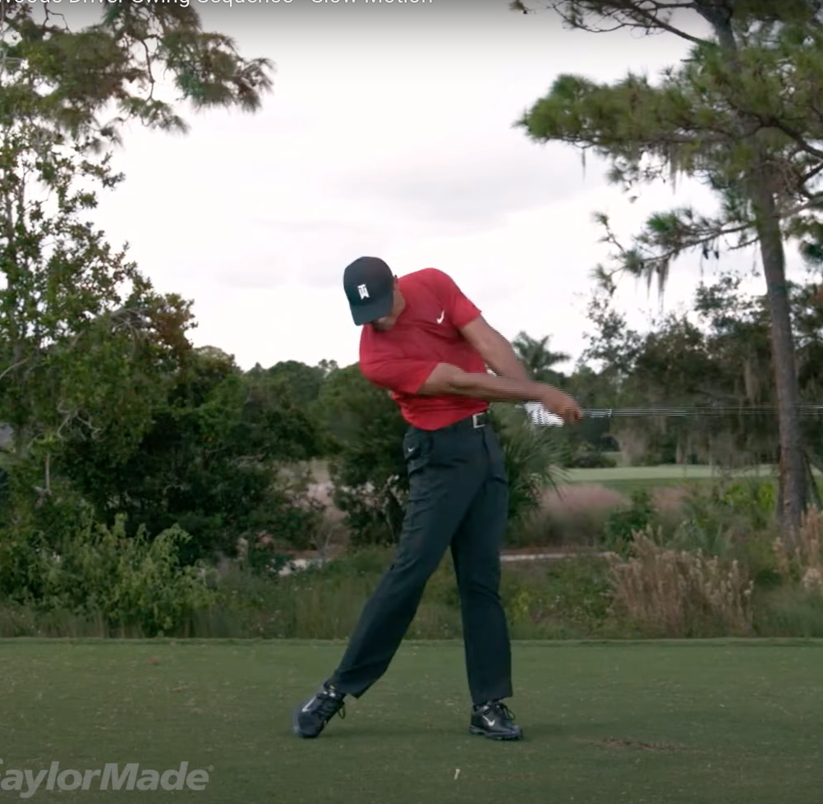
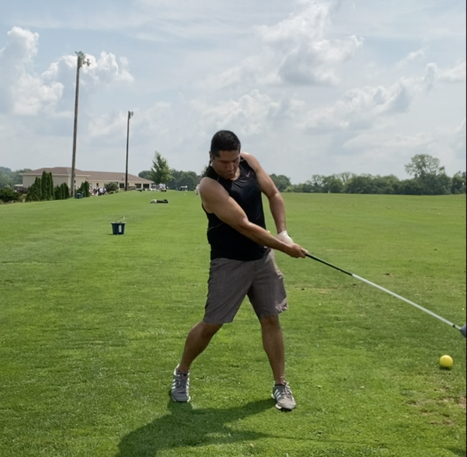
Tiger Left elbow angle: 185 deg
Luis Left elbow angle: 196 deg

Slide 7
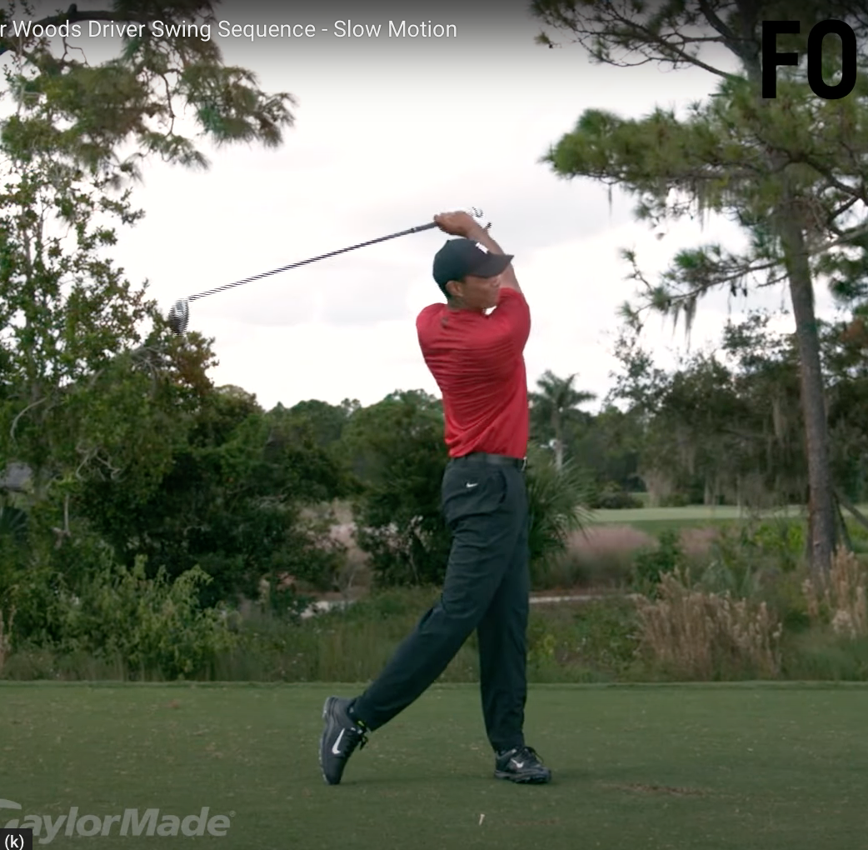
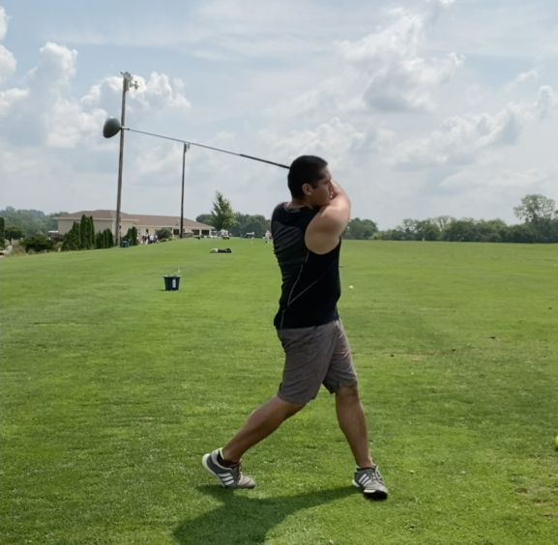
Tiger Avg Driving Distance 295 yds
Longest drive ~500 yds
Luis Avg Distance 140 yds
This Drive Distance ~200 yds

